Slide 1
Online Safety Workshop for Parents and Carers
Aims:
Understand the risks and challenges from
children’s online activity
Review the current online safety measures
Understand the apps used by children and the risks
Review children’s use of apps and control measures
Establish future actions and the focus for future for training and learning

Slide 2
How did we get to where we are now?
Sir Tim Berners-Lee creates the world wide web in 1989
First tablet in 1989 and iPad in 2010
Smartphones developed from 1994
Email communication overtakes conventional mail and letters in 2002
Media and government very slow to act, with first online safety laws for UK in 2019
1999: Newsnight | Today is #InternetDay… To mark this auspicious occasion, here’s David Bowie speaking to Jeremy Paxman in 1999 about the "unimaginable" effects on society... | By BBC Archive - Facebook | Facebook

Slide 3
The opportunities and challenges to consider from online activity:
What are the benefits of the internet?
Why do we need to think about online safety?
Are digital devices set up to protect?
How does online activity identify us, and who we are?
Who is the person most likely to keep a child safe?
What are the hazards and risks?

Slide 4
What are the online safety risks?
Abusive messages and cyberbullying
Online hate and discrimination
Radicalisation and county lines
Fake news and misinformation
Inappropriate content (not age appropriate)
Grooming and sexual exploitation
Damaged online reputation from the children’s own online activity and posts
Privacy and identity theft (phishing)
Emotional welfare and self harm
Screen time (e.g. from gaming)

Slide 5
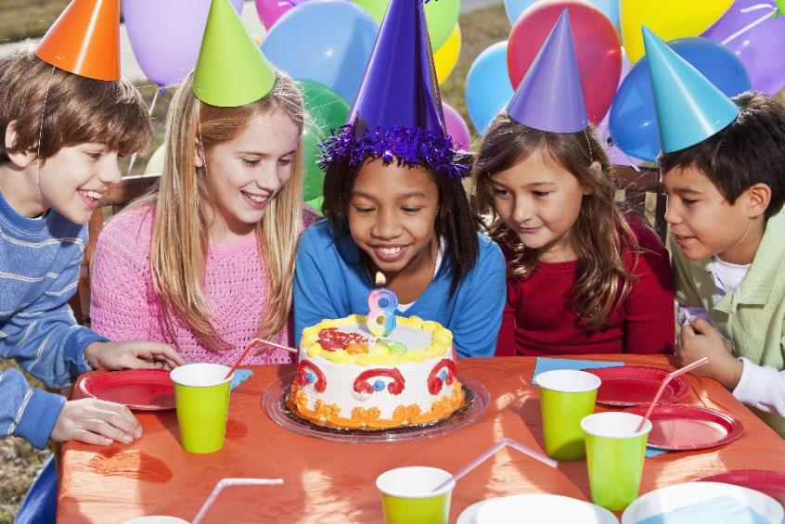
Questions to consider regarding personal Information:
What type of information may children include online?
What information can we find out from these images?
Can people gain data without conscious sharing of information?

Slide 6
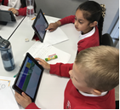
What are Online Safety measures at Hounslow Heath School?
Online Safety Policy (available soon on website)
LGfL firewall and monitoring
Rules, AUPs and guidelines reviewed annually (pupils/staff)
guidance by staff (included on p.13 of the KS2 Primary Planner)
online safety teaching in class throughout the year
Digital Ambassadors working with classes and leads
SLT with children and families
Online Safety Newsletters

Slide 7
What online apps are used?
Currently there at least six significant concerns reported each term that relate to messaging and social media outside school (for school systems there are 2-3 per year).

Slide 8
National Data on the Use of Apps
* children are online for 3-4 hours a day (Ofcom 2022)
* use of adult YouTube (78%) to YouTube Kids (24%)
* by the age of 11, 59% of children in UK use social media/gaming platforms (e.g.TikTok, Snapchat and Discord)
What are the platforms and apps used by children?
(percentage of children in UK using each app - Statista)
2018 2021
YouTube 61% 78%
Roblox 21% 23%
TikTok 10% 50%
Snapchat 27% 42%
Whatapp 43% 53%

Slide 9
Children by the age of 11: * 59% use social media regularly * 91% use messaging services * 95% access online video-sharing
Is this okay? Why not?
At what age should children start to use social media platform?
(Guidance is 13 years old for most apps!)
By the age of 12, 55% have bad experiences and 69% aware of online reporting, 27% aware of end to end encryption.

Slide 10
What is Roblox?
Roblox is one of the world’s most popular video game sites, with nearly 200 million monthly users, mostly between the ages of 9 and 15.
Roblox is more than a single game: it’s a huge collection of different games made by a range of creators using the platform’s built-in tools. Pretty much anyone with the knowledge of how to do so can create a game on Roblox like Minecraft.
Roblox offers a vast quantity of games for children of all ages. It also actively encourages kids to play with up to 100 other people and to be creative thinking about making their own games.
For many children, Roblox will be one of the first places where they interact online with other people, whether via the platform’s in-game chat options or by adding ‘friends’ and sending them messages. It has found itself in the news more than once due to fears over its safety.
Roblox uses an in-game text-chat. This content is monitored regarding personal details or inappropriate language. There is a risk that children could be encouraged to chat with players outside of this moderated chat, as other platforms may not have the same level of moderation.
To play Roblox, parents need to set up an account for their child. This is achieved on the device itself for PC, tablet and smartphone. Parents need to specify the age of their child, as under 13. In the Security section of the account, set an account PIN to ensure that these settings can't be changed.
Although Roblox is PEGI 7+, the user-created content falls outside this may contain elements that are only suitable for older children. You can also block users by going to their profile. Once blocked, you will no longer be able to interact with that player.onger be able to interact with that player.
Children can feel a lot of pressure to spend money on Roblox or Robux, either from their peers, professional streamers or the games themselves.

Slide 11
What is Tiktok?
TikTok is one of the most popular social media apps, with short-form video focus, and a favourite tool of expression and communication.
TikTok requires its users to be at least 13 years old (12+ on Apple's App Store and "Parental Guidance Recommended") Note that TikTok will accounts will be taken down if moderators suspect that the individual with an account is under the age of 13.TikTok have been involved in monitoring and work with other agencies (accounts don’t require adding of information to profiles). However, users are able to turn off the default limit themselves (or of course lie about their actual age when signing up).
Users don’t need an account to watch videos on TikTok but are invited to like, comment, customise feed or create their own video content; prompted to sign up for free accounts). People are allowed to let their imagination run wild on TikTok, as there isn’t really a ‘right’ or ‘wrong’ type of content; to pick up new skills, learn how to play an instrument or even connect with people to share interests.
In 2021 TikTok updated its privacy settings so that accounts for under-16s are set to private by default. This means that other users must be approved before they can see and interact with children’s content or contact them. In TikTok has introduced a daily screen time cap of 60 minutes.
TikTok offers its users a range of settings for safety, which they refer to as ‘Family Pairing’. These settings allow parents to control elements of their child’s TikTok account if their child is under 16.
TikTok received a record-breaking fine from the US Federal Trade Commission (FTC) of £4.2m and harsh criticism from the UK’s Information Commissioner's Office (ICO) for illegally collecting the data of children under 13,.
The social media platform is famous for spawning viral challenges which are a big draw for many users. But TikTok has received a lot of flak for allowing potentially dangerous challenges, such as the Skullbreaker Challenge and the Outlet Challenge.

Slide 12
What is Snapchat?
Snapchat is a popular photo-messaging app that allows users to take and share photos, record videos, add drawings. A message on Snapchat only appears for a few seconds, but once you click away or the time limit expires, it disappears from sight, but images can be saved.
Snapchat has evolved into more than simply a photo messaging app. Snapchat has a number of different features. These include ‘stories’, that ‘disappear’ after 24 hours, but can be copied.
There is also a ‘live streaming’ option, in which you create a story with other users based on your location. This is only available when your geo-location is enabled, a huge vulnerability. In 2023 Snapchat announced that their AI chatbot 'My AI' would be made freely available to all users.
As of 2022 Snapchat has over 330 million daily active users, and young people are particularly prominent among its user base. Its popularity among young people can be explained by its fun, visual nature and the immediacy it offers in interactions.
Snapchat states that young people under the age of 13 years are not able to create an account. However, there is no strict age verification in place when signing up to the app.
In August 2022 Snapchat introduced their 'Family Center', an in-app tool that allows parents to see who their children have been speaking to. The Family Center’ will not, however, reveal the content of any messages. Because of the ‘disappearing’ effect of images, Snapchat has been used for sharing inappropriate images. The momentary nature of Snapchat can mean that young people may be more inclined to take images on impulse that they might later regret.
Like many other apps, there is a concern that strangers can contact young people directly by sending images and requesting to become ‘friends’.
You can report users that breach the Community Guidelines by contacting Snapchat directly. If you have any concerns about grooming, sexual abuse or exploitation on Snapchat, you can also file a report with CEOP.

Slide 13
What can we do to protect children from harm when using apps?
There are a wide range of steps we can take to protect the children from harm.
What are these steps?
Children tend to feel that their own online world is private, and are not keen to share it with adults (including parents and teachers).
They are not yet equipped to keep themselves safe (hence the age limit of 13).
Communication with children is crucial; ensuring they talk and notify you when online.

Slide 14
Parental Control Settings
After establishing communication, setting parental controls are vital. From age-specific online safety checklists, to guides on how to set parental controls on a range of devices, you’ll find a host of practical ideas below to help children get the most out of their digital world.
Parental Controls for Social Media:
https://www.internetmatters.org/parental- controls/entertainment-search-engines/
Parental Control links regarding broadband & mobile networks:
https://www.internetmatters.org/parental-controls/broadband-mobile/
Parental Controls for Gaming Consoles:
https://www.internetmatters.org/parental- controls/gaming-consoles/
Parental Controls with Smart Phones and Other Devices:
https://www.internetmatters.org/parental-controls/smartphones-and-other-devices/
Parental Controls for Search Engines Entertainment and Media:
https://www.internetmatters.org/parental-controls/entertainment-search-engines/

Slide 15
Parental Filtering and Monitoring
Parental control Settings
The school uses the LGfL firewall and LGfL Home Protect filter for mobile devices. We are looking at a new contract allowing rolling out to personal devices at home. Would this interest you?
Online Monitoring at Home can be support through resources within the link below:
https://www.internetmatters.org/resources/monitoring-apps-parents-guide/
Screen time for iPad & iPhone (this a free resource):
Use Screen Time on your iPhone, iPad, or iPod touch - Apple Support
Google Family Link (a free resource so you decide what’s best for your family). The easyto use tools allow you to understand how your child is spending time on their device,share location, manage privacy settings, and more:
https://families.google/familylink/
Circle (a paid app so not free) is an award-winning parental controls app letting you manage screen time and monitor not just some, but ALL websites and apps. With a complete in-
home and on-the-go solution, you set the rules for sites like YouTube, TikTok,
Discord (and many more) across all your family’s connected devices:
https://meetcircle.com
Boomerang Parental Controls (a paid app so not free):
https://useboomerang.com
Qustodio (a paid app so not free) is an all-in-one parental control and digital wellbeing solution:
https://www.qustodio.com/en/
OurPact (a paid app so not free) is a parental control and family locator app:
https://ourpact.com

Slide 16
Reporting Online Concerns
Report online safety concerns immediately to the Online Safety Coordinator or another senior leader at your child’s school.
Using the Report Harmful Content link below can help you to report harmful content online; providing up-to-date information on community standards and direct links to the correct reporting facilities across multiple platforms.
https://reportharmfulcontent.com
Report and Remove is there to help young people under18 in the UK
to confidentially report sexual images and videos of themselves and remove them from the internet.
https://www.childline.org.uk/info-advice/bullying-abuse-safety/online-mobile-safety/report- remove/
Ditch the Label can be used to report Cyber Bullying and Online abuse. If this is a school matter, report to the school as police will refer you to the school.
https://www.ditchthelabel.org/report/

Slide 17
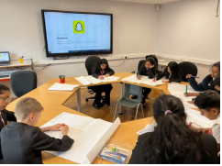
Enjoy being safe when online.
Safer Internet Day will be on Tuesday 6th February

Slide 18
The Current Focus on Online Safety in and Beyond School
Online Security Children always with an adult (talking). They are taught to be safe online.
They use secure devices and systems with effective settings and filters.
Children’s Use of Apps and Platforms
Children to use appropriate apps with permission.
(NB; peer pressure is more powerful than adult advice)
Children to take responsibility for their own safety and those of others (actions online) ’ You are the key to your own safety.’
Current school online safety target is for children talk to responsible adults about social media and inform them when online (messaging and sharing data)

Slide 19
What are our action points for this summer and the start of term?
Continue the target to develop communication with children about apps and their own online activity.
Develop communication between responsible adults about apps, including emails and Online Safety Newsletter.
Review controls, monitoring, filtering and reporting across the school community.

Slide 20
Queries and Requests Raised by Parents
Over to you; are there any other
matters to discuss or investigate?
Would additional workshops or sessions be of value?
Is there anything you would like more support with? (e.g. 1:1)
Are there matters we can take forward to future workshops, newsletters, pupil learning and online safety systems.
Q: Would we be able to have workshops or sessions including the children? A: We can have smaller groups of parents or a family session with the child but cannot have children talking to other parents about their online use. Please email Mr Gwilliams if you would like a small group session for additional support
Q: Could praise be used to reward online behaviour? A: The school does reward good behaviour and achievement, but we will look to do more following the competition last year.
Q: Could more children take mobile phones to school. The risks and challenges of children doing this were discussed so mobile phones are only permitted in exceptional circumstances after prior agreement with the school.
Q: Could there be more support in spotting signs of emotional harm and wellbeing concerns. A: This is carefully monitored in school. While this is principally safeguarding, we will try make emotional wellbeing online a key consideration for a future workshop.

Slide 21
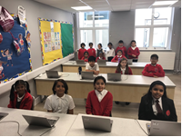
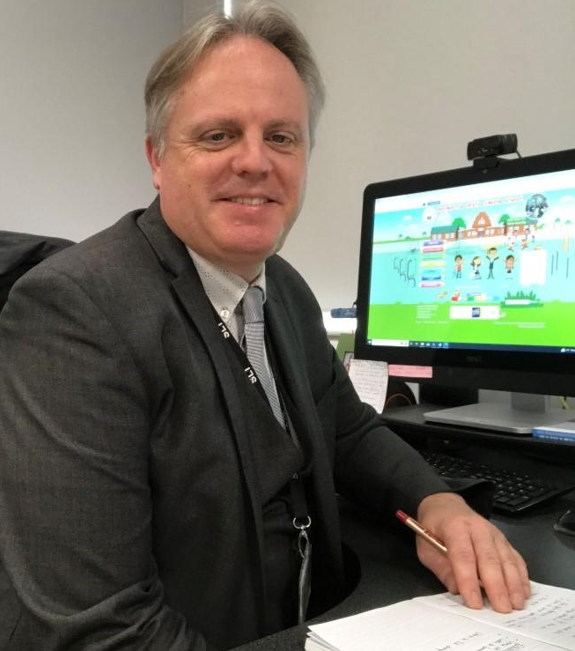
Thank you for taking part. It is vital that we work together to protect the children and meet their needs. Keep communicating with the school, not just following online safety concerns or incidents. Email Mr Gwilliams through the school office at office@hounslowheathschool.com with any suggestions queries or concerns.
school
parent
child

