Slide 1
Online Safety Workshop for Parents/Carers Wednesday 22nd May 2024 Thursday 23rd May 2024 Key Stage 2

Slide 2
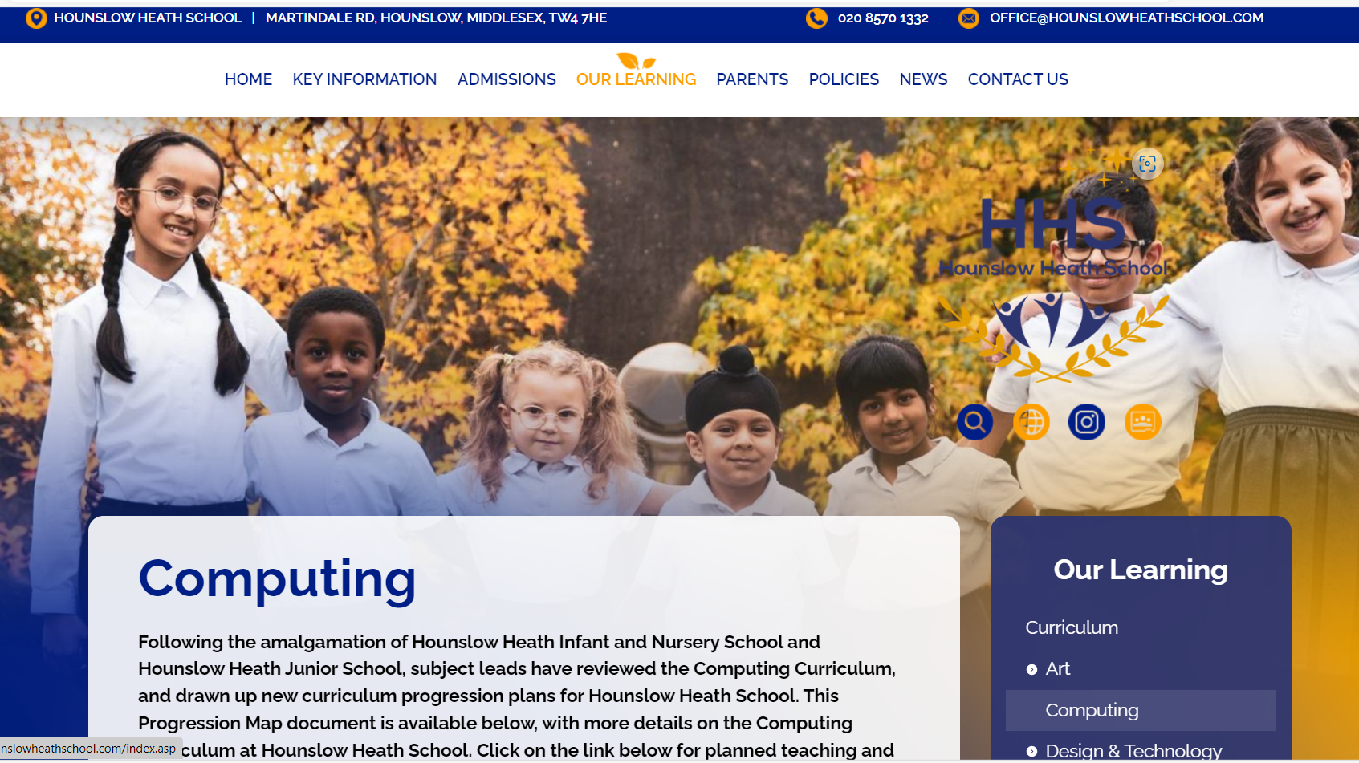
Resources for curriculum areas including Computing and Online Safety are on the school website: KS2
curriculum planning and learning is available through Progression Maps within Our Learning Curriculum pages
weekly updates on planned learning are available every Friday through your child’s Google Classroom
Online Safety Policies, guidance and resources are available within the Policies tab

Slide 3
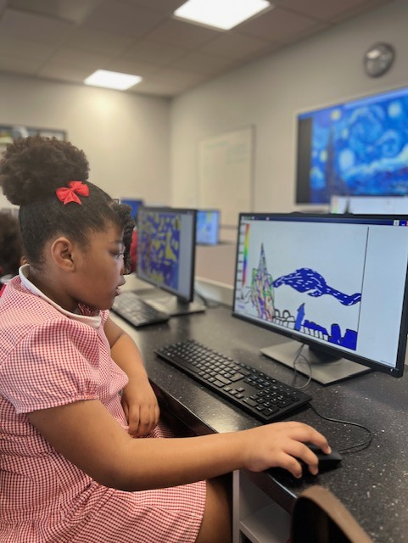
Online Safety Parent Workshop Aims: KS2
As your child explores and uses the digital world, it is essential to ensure they do so safely.
Today we are going to talk about important online safety information, guidance and resources to help you support your child’s internet use effectively.
understand the risks and challenges from children’s online activity
review the current online safety measures
understand children’s activity including apps used and risks
review children’s use of apps and control measures
establish future actions including focus on resources learning and future training

Slide 4
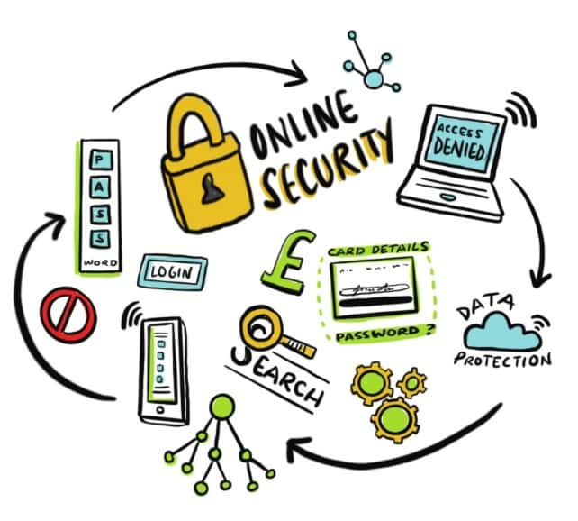
A Balanced Look at Online Activity KS2
What are the benefits of the internet?
Why do we need to think about online safety?
Are digital devices set up to protect?
How does online activity identify us, and who we are?
Who is the person most likely to keep a child safe?
What are the hazards and risks?

Slide 5
Historical Context and History for Online Activity: EYFS & KS1
Sir Tim Berners-Lee creates the world wide web in 1989
first tablet in 1989 and iPad in 2010
smartphones developed from 1994
email communication overtakes conventional mail and letters in 2002
mainstream media and government very slow to act, with first online safety laws for the UK in 2019 (Hounslow Heath AUPs and guidance were in place more than a decade before)
YouTube

Slide 6
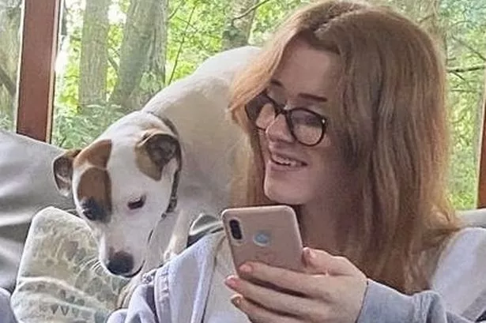
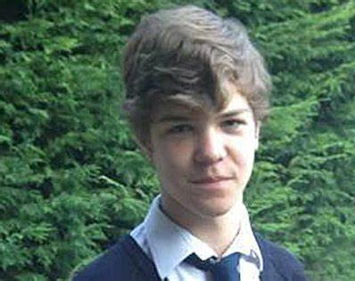
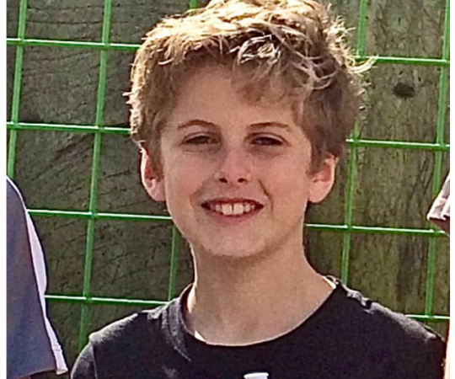
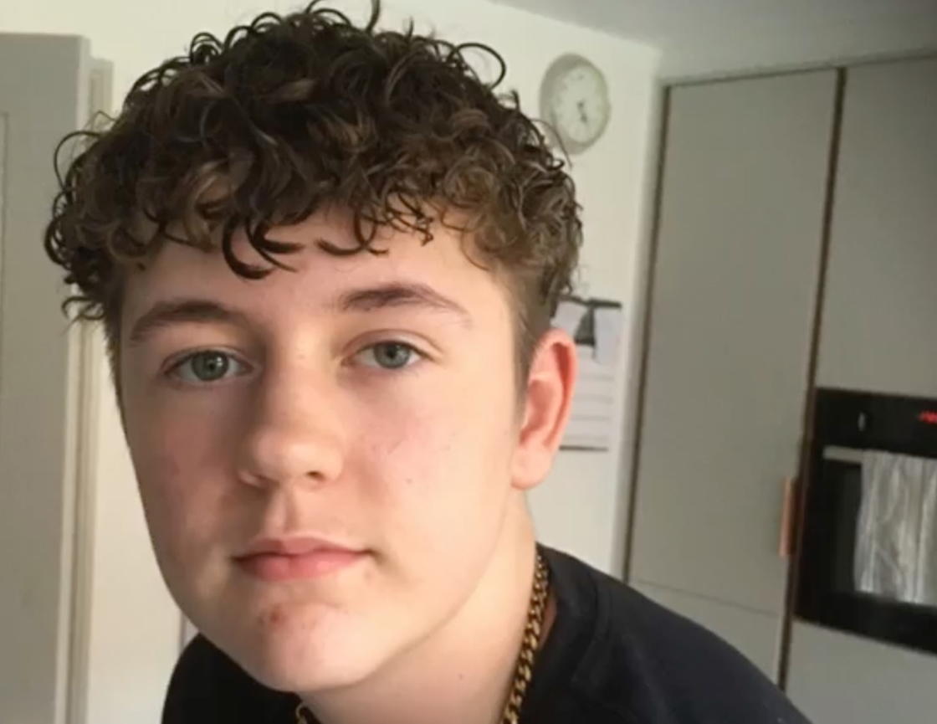
What do these children have in common?
(Social media and online activity has contributed to their deaths.)

Slide 7
screen time (e.g. from gaming)
abusive messages and cyberbullying
online hate and discrimination
grooming and sexual exploitation
radicalisation and county lines
inappropriate content (not age appropriate)
fake news and misinformation
privacy and identity theft (phishing)
damaged online reputation from the children’s own posts
emotional welfare and self harm
What are the risks?

Slide 8
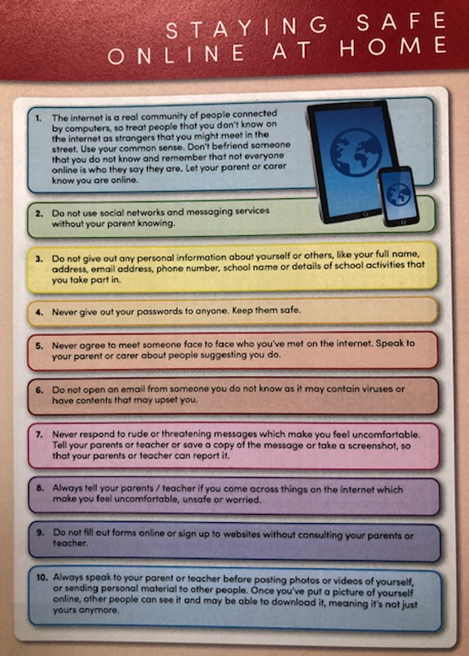
Online Safety Policy (updated document available soon on website)
LGfL firewall and monitoring
Acceptable User Policies signed annually (pupils and staff)
guidance (first 10 AUP rules) on p.13 of Primary Planners
online safety teaching and learning throughout the year, including the start of each Olus topic
Digital Ambassadors working with classes and school leads
staff including SLT working directly with children and families, including online safety workshops
Online Safety Newsletters
additional resources on website including Schools Mobile.com platform
What is the school doing to keep everyone safe?

Slide 9
1. I will not befriend someone that I do not know and remember that not everyone online is who they say they are. I will let my teacher or parent know I am online.
2. I will not use online messaging, chat-rooms or social network websites without permission; from my parents when outside school, or from teachers when messaging in school. With permission I will use them respectfully and safely.
3. I will not give my home address, phone number, or send a photograph, or video, or give any personal information on the internet which could be used to identify me, my friends or my family.
4. I will keep my login names and passwords secret and only pass it onto the member of staff or parent when necessary, not with anyone else, such as friends or brothers, sisters or cousins.
5. I will not agree to meet someone face to face who I have met on the internet.
6. In school I will only use websites agreed with my teachers and parents to send messages; and only open a message, attachment, or download a file with permission, knowing who sent it.
7. I will always be polite and sensible with others when sending messages, emails or anything else when using computers and the Internet.
8. If I see anything I am unhappy with, or get a message I do not like, I will not reply or respond to it, but will close it and report it; telling a teacher or responsible adult straight away.
9. I will not fill out forms online or sign up to websites without my teacher or parent being with me.
10. I will only record photos and videos or upload photos and videos online (e.g. on iPads) with permission, when supervised by teachers or parents.
11. When on the school’s computer or mobile device I will use it only for schoolwork and homework, using agreed websites and Search Engines.
12. I will only bring in agreed files and send work through agreed websites.
AUPs remain and will be expanded to Key Stage 1
I know that if I don’t follow these rules, the school may take action to keep everyone safe, including meeting with parents and restrictions to access online.

Slide 10
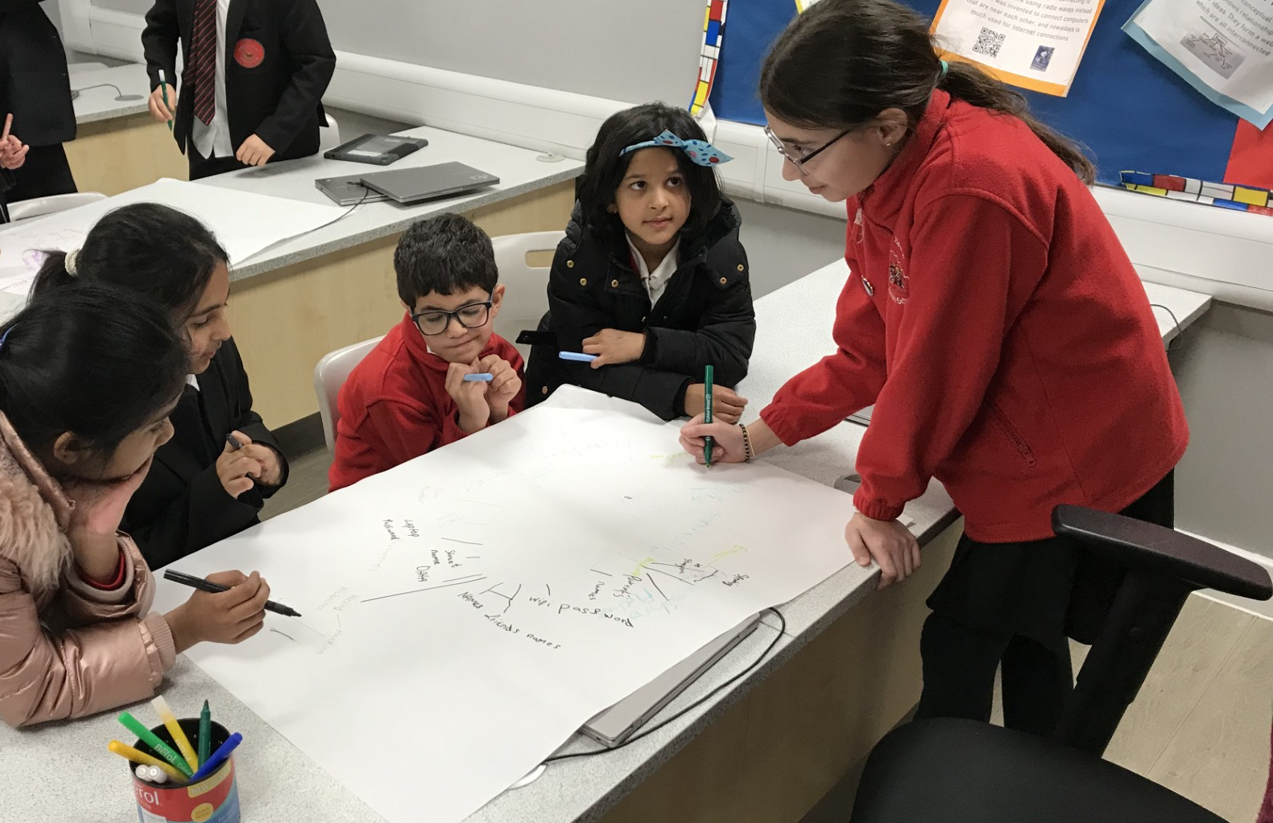
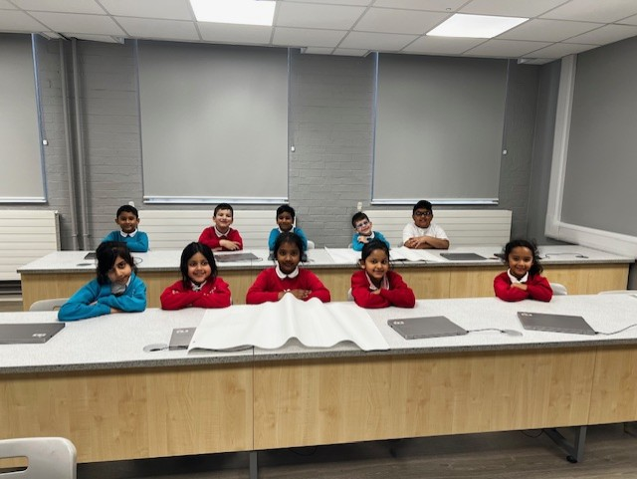
Our Digital Ambassadors have been working hard as a team, with their own classes and school leads including Mr. Gwilliams and Miss Farley!
They have identified a target for each year group:
Year 1 and 2: carefully choose what we say online and keep our personal information safe Year 3: choose and use online games and apps carefully; communicating safely with others Year 4: use messaging and online communication through games and emails safely (with our parents’ knowledge) Year 5: manage communication online safely; reporting not responding to unpleasant messages and cyberbullying Year 6: use advice from responsible adults to manage use apps and social media safely.
Then they looked at how we do this and achieve our goals. We are providing support and advice to our year groups and the school through advice and posters for the ICT Suites and classrooms.
Well done Digital Ambassadors!
Digital Ambassadors

Slide 11
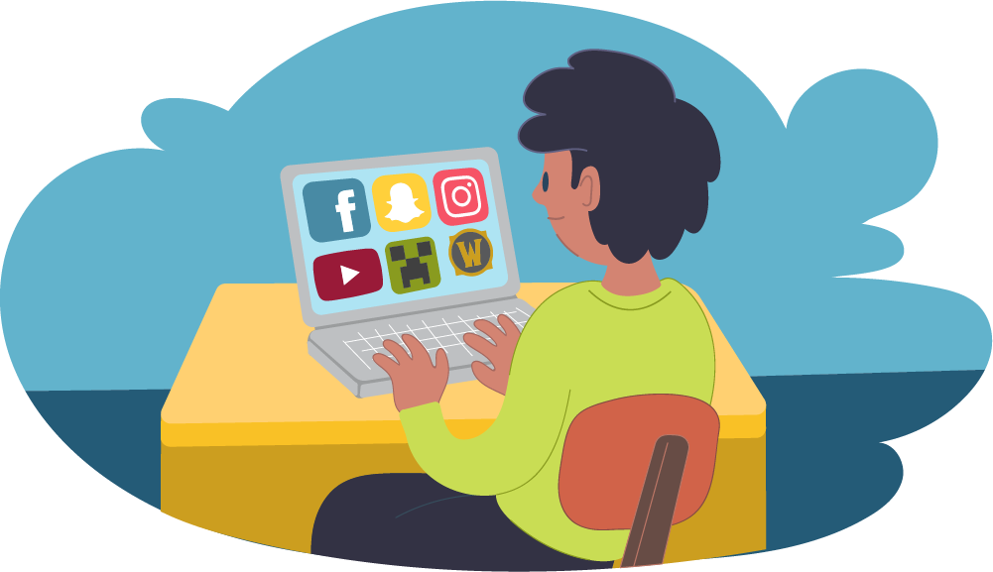
Stay Informed: regularly update yourself with online safety practices and emerging risks.
Communicate: through open conversations with your child about their online activities and experiences.
Set Rules: establishing clear rules and guidelines for internet use at home (using the AUPs)
What basic practises can we develop beyond school boundaries?
Monitor online activity in person: (more challenging as your child gets older) limiting the amount of time your child spends online
Healthy activity: balance screen time with other activities, such as outdoor play and reading

Slide 12
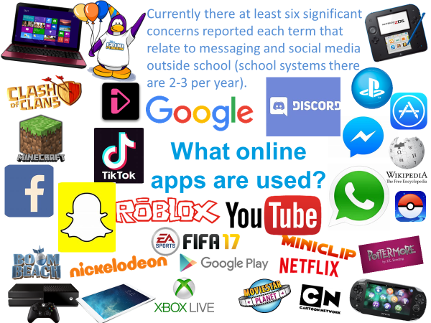
What do we need to monitor beyond the school boundaries?

Slide 13
Children by the age of 11:
59% use social media regularly
91% use messaging services
95% access online video-sharing
What online activity is taking place?
Is this okay? Why or why not?
At what age should children start to use social media platform?
(Guidance is 13 years old for most apps.)
By the age of 12, 55% have bad experiences and 69% aware of online reporting, 27% aware of end to end encryption.

Slide 14
National Data on the Use of Apps
* children are online for 3-4 hours a day (Ofcom 2022)
* use of adult YouTube (78%) to YouTube Kids (24%)
How much of this online activity is taking place?
Where?
* by the age of 11, 59% of children in UK use social media/gaming platforms (e.g.TikTok, Snapchat and Discord)
What are the platforms and apps used by children?
(percentage of children in UK using each app - Statista)
2018 2021
YouTube 61% 78%
Roblox 21% 23%
TikTok 10% 50%
Snapchat 27% 42%
Whatapp 43% 53%

Slide 15
What can we do to protect our children from harm?
There are a wide range of steps we can take to protect the children from harm.
What are these steps?
Children tend to feel that their own online world is private, and are not keen to share it with adults (including parents and teachers).
They are not yet equipped to keep themselves safe (hence the age limit of 13 for social media apps).
Communication with children is crucial; ensuring they talk and notify you when online.

Slide 16
Childnet: Childnet offers resources and advice for keeping children safe online.
NSPCC: NSPCC Online Safety provides tips on setting up parental controls and discussing online safety with your child.
ThinkUKnow: resources and support are provided with Online Safety for Home learning
ParentZone: ParentZone offers specific advice on apps and social media.
Online Safety Workshops: Hounslow Heath School provides PowerPoints for any workshops, including links to monitoring, filtering and reporting
SchoolMobile.com: The school will shortly post a link to this platform for parents and carers to sign up for this provision for monitoring and filtering online content.
Important Resources available online and on the website:

Slide 17
Parental Control Settings
After establishing communication, setting parental controls are vital. From age-specific online safety checklists, to guides on how to set parental controls on a range of devices, you’ll find a host of practical ideas below to help children get the most out of their digital world.
Parental Controls for Social Media:
https://www.internetmatters.org/parental- controls/entertainment-search-engines/
Parental Control links regarding broadband & mobile networks:
https://www.internetmatters.org/parental-controls/broadband-mobile/
Parental Controls for Gaming Consoles:
https://www.internetmatters.org/parental- controls/gaming-consoles/
Parental Controls with Smart Phones and Other Devices:
https://www.internetmatters.org/parental-controls/smartphones-and-other-devices/
Parental Controls for Search Engines Entertainment and Media:
https://www.internetmatters.org/parental-controls/entertainment-search-engines/

Slide 18
Parental Filtering and Monitoring
The school uses the LGfL firewall and LGfL Home Protect filter for mobile devices. We are looking at a new contract allowing rolling out to personal devices at home. Would this interest you?
Online Monitoring at Home can be support through resources within the link below: https://www.internetmatters.org/resources/monitoring-apps-parents-guide/
Screen time for iPad & iPhone (this a free resource):
Use Screen Time on your iPhone, iPad, or iPod touch - Apple Support
Google Family Link (a free resource so you decide what’s best for your family). The easy to use tools allow you to understand how your child is spending time on their device,share location, manage privacy settings, and more: https://families.google/familylink/
Circle (a paid app so not free) is an award-winning parental controls app letting you manage screen time and monitor not just some, but ALL websites and apps. With a complete in-home and on-the-go solution, you set the rules for sites like YouTube, TikTok, Discord (and many more) across all your family’s connected devices: https://meetcircle.com
Boomerang Parental Controls (a paid app so not free): https://useboomerang.com
Qustodio (a paid app so not free) is an all-in-one parental control and digital wellbeing solution: https://www.qustodio.com/en/
OurPact (a paid app so not free) is a parental control and family locator app: https://ourpact.com

Slide 19
Reporting Online Concerns
Report online safety concerns immediately to the Online Safety Coordinator or another senior leader at your child’s school.
Using the Report Harmful Content link below can help you to report harmful content online; providing up-to-date information on community standards and direct links to the correct reporting facilities across multiple platforms: https://reportharmfulcontent.com
Report and Remove is there to help young people under 18 in the UK to confidentially report sexual images and videos of themselves and remove them from the internet: https://www.childline.org.uk/info-advice/bullying-abuse-safety/online-mobile-safety/report- remove/
Ditch the Label can be used to report Cyber Bullying and Online abuse. If this is a school matter, report to the school as police will refer you to the school: https://www.ditchthelabel.org/report/

Slide 20
There is a new platform for simplifying the filtering and monitoring of online activity at home.
More details will be available on the website soon.

Slide 21
We would very much appreciate the completion of the Online Safety Parent Survey when sent to you in order to ensure that guidance and support is targeted to where it is needed.
We will be surveying parents, carers and pupils.

Slide 22
By working together, we can help our children enjoy the benefits of the internet while staying safe.
Key Actions:
develop communication with children regarding their online activity (more challenging as children get older)
set expectations for independent online activity
ensure the year group target is achieved
develop monitoring and filtering systems for children’s independent online activity
Q and A Queries:
do you have any further queries or questions?
are you interested in signing up for online safety systems?
is there anything you would like more support with?
would additional workshops or sessions be of value?
are there and areas to take forward to future workshops?
Working Together Into the Future

